Slide 1

Dr. Charles Severance
Sakai PMC Chair
University of Michigan
Sakai Chief Strategist, Longsight

Slide 2

Disclaimer...
What I am about to talk about is not an official direction or position of the University of Michigan, Longsight, nor IMS Global.

Slide 3

A Banner Year

Slide 4


Core Values
Open Source
Open Community
Open Planning / Roadmap
Our "shareholders" are the adopters and users

Slide 5
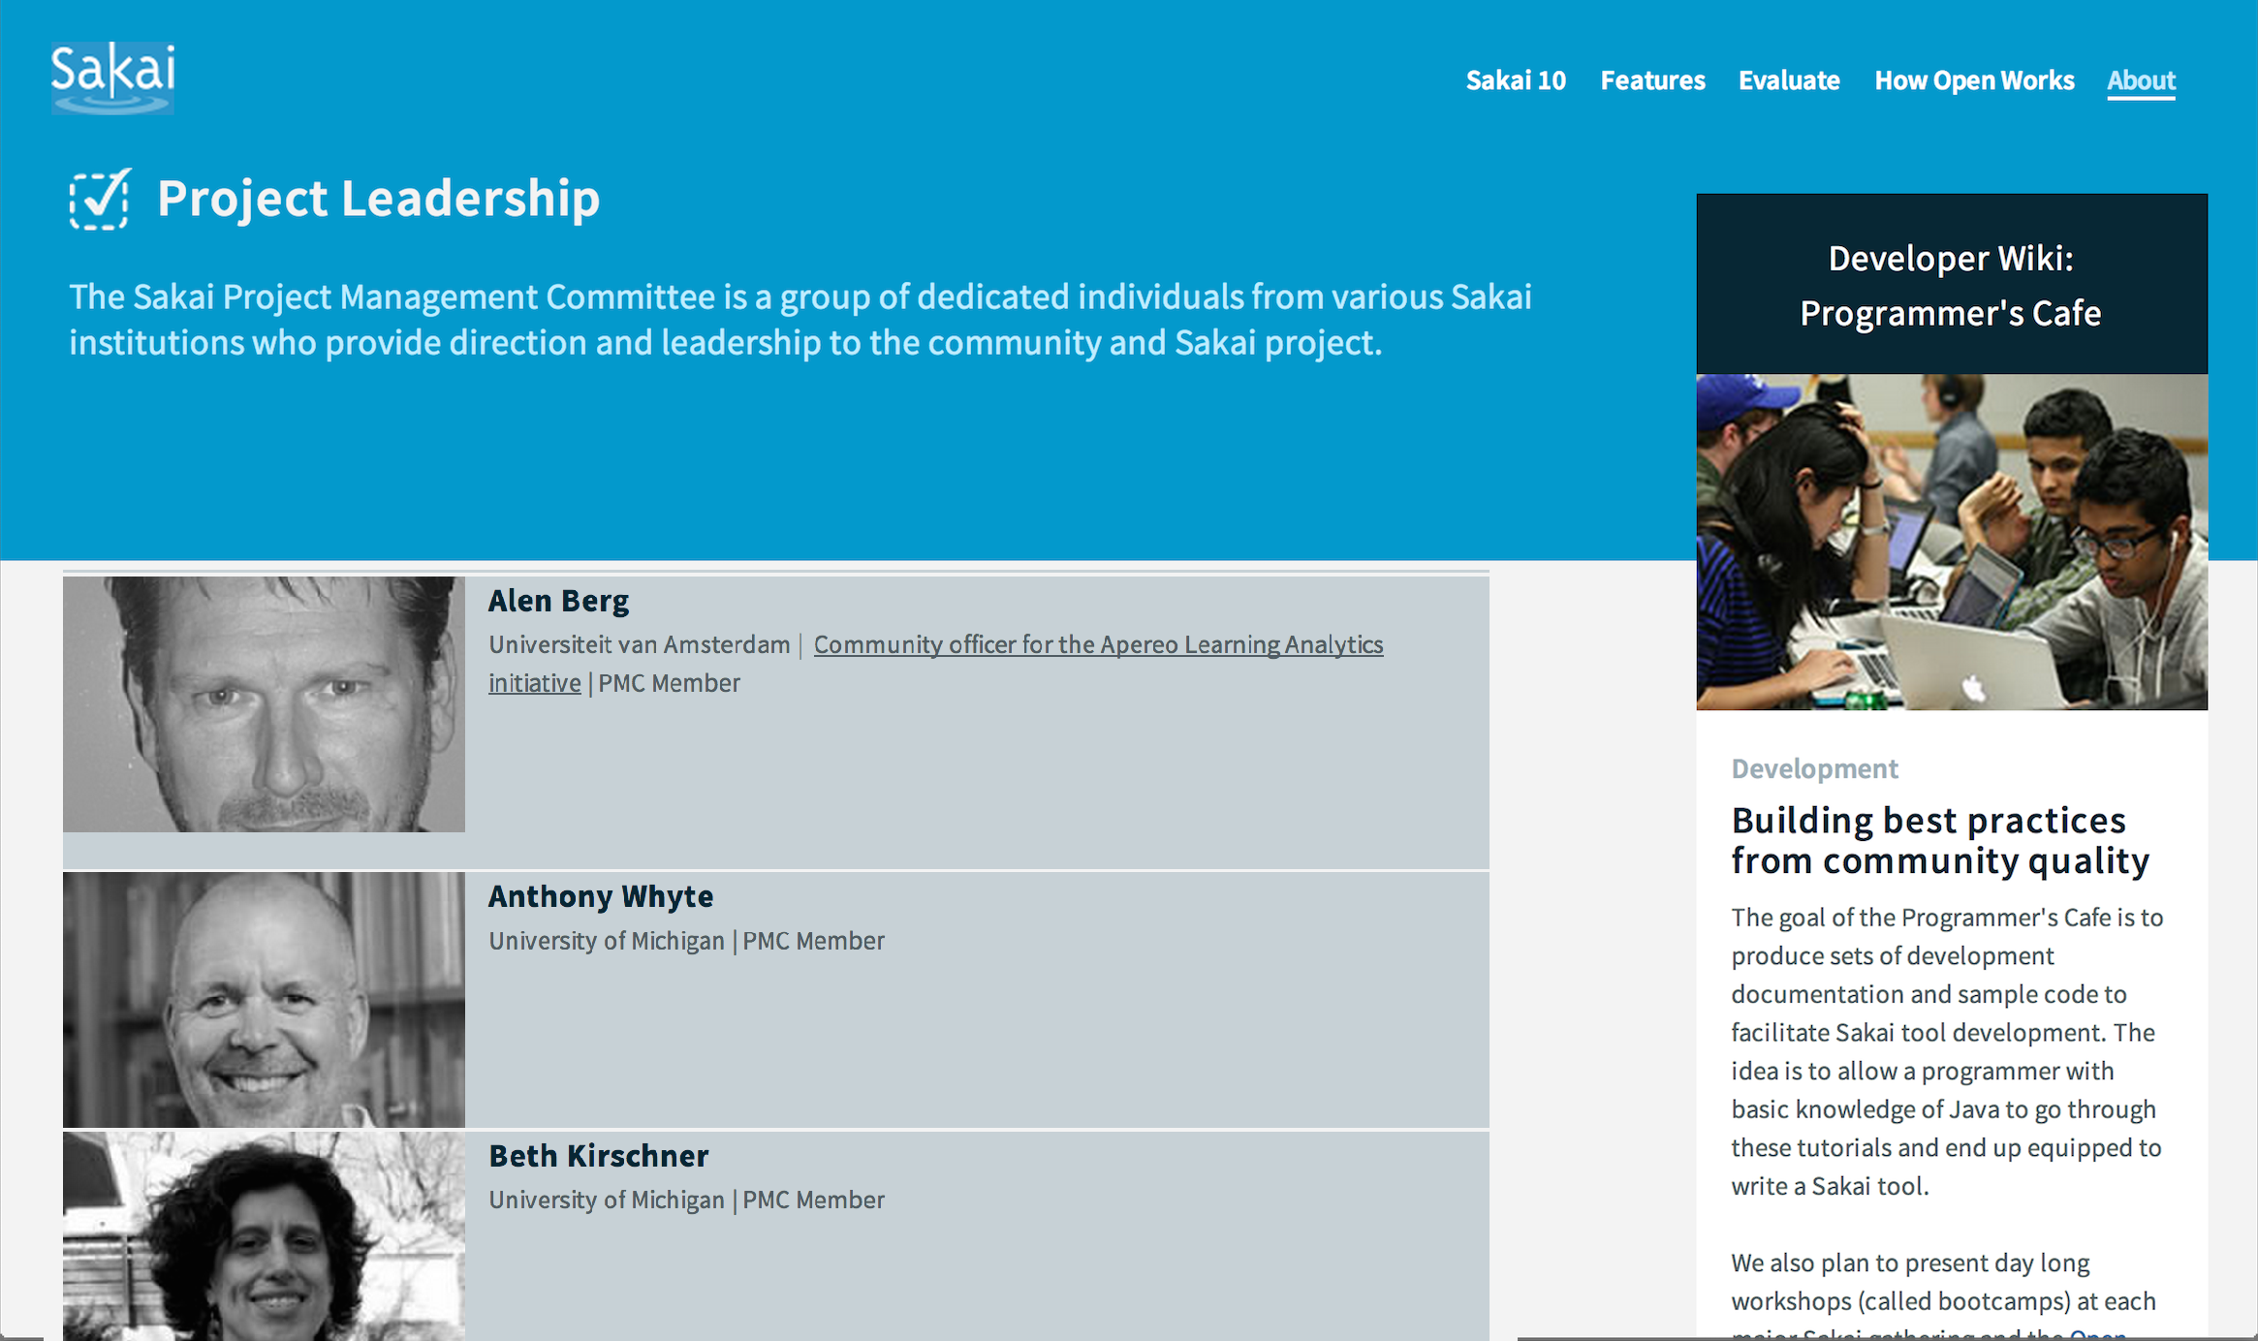
Leadership Team

Slide 6

Technology Leadership
Leading the way in cross-LMS interoperability
Helped found of major IMS Standards
Learning Tools Interoperability (IMS LTI)
Common Cartridge (IMS CC)
First to ship most IMS standards
Most recently IMS LTI 2.0 in Sakai 10

Slide 7

A Decade of Innovation
Sakai 2.9 – Summer 2013
Best in class course navigation
Best in class Lesson Builder (Last major feature)
Sakai 10 – Summer 2014
Improve cost of cloud hosting
UI Improvements / MOOC Influence
Sakai 11 – Fall 2015
Responsive design throughout
UI Surprise and Delight

Slide 8
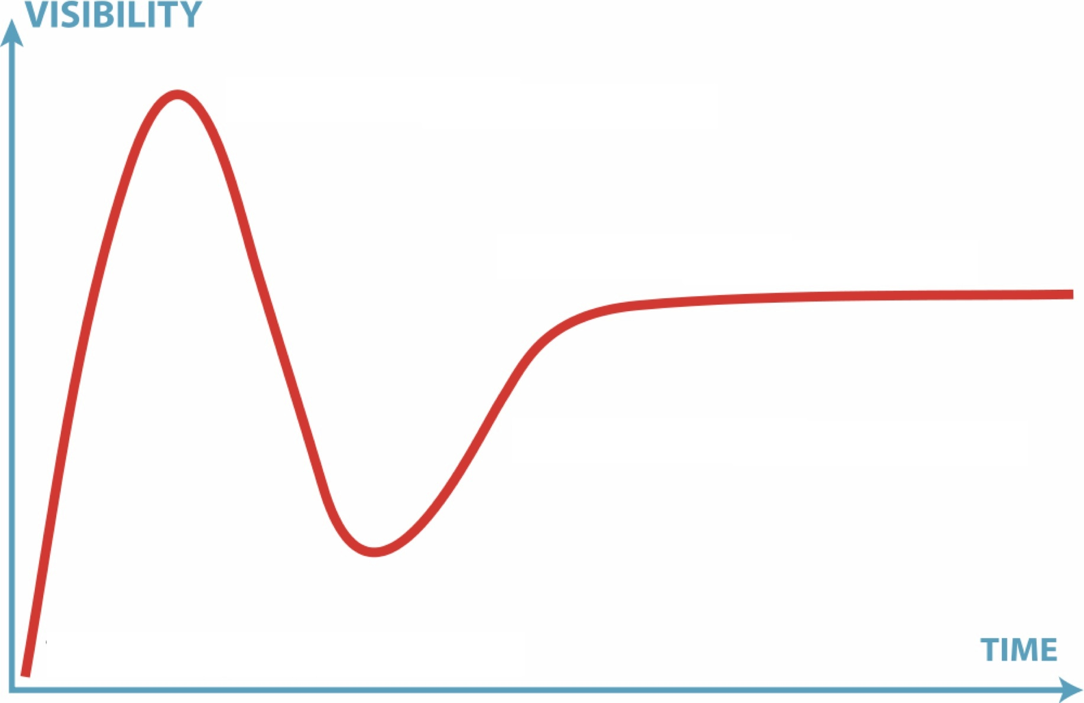

Perception Versus Reality
11
2.9
10
2.6
2.7
2.8
2.5
2.0
1.0
1.5

Slide 9
Sakai 10 (partial List)
Peer Grading Assignments
Group Assignments
Help Improvements
Forums "MOOC-like"
Test and Quizzes – All HTML5 recorder
Syllabus Improvements
Improved messaging
Lesson Builder
Peer rubrics
Polls
Rich Text Editor
Audio record HTML5
Accessible (ARIA)
MathML
Grade Book Extra Credit
Drag/Drop Upload

Slide 10
Roadmap for Sakai 11
Historically we have avoided extensive roadmap discussions
Unpredictable resources
Governance layers / expectations / approvals
The governance of Sakai is clear
Commercial providers resources are more consistent

Slide 11
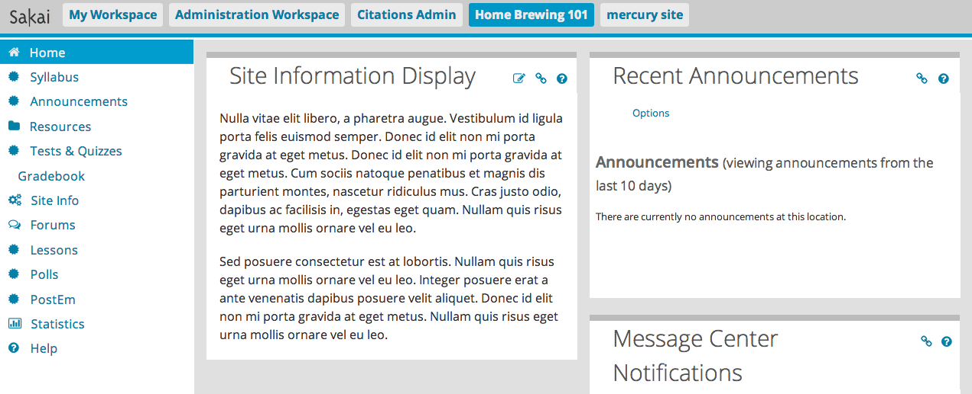
Sakai 11 – Bold Innovation

Slide 12
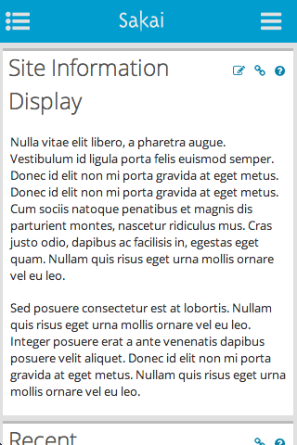
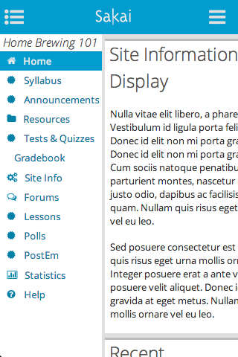
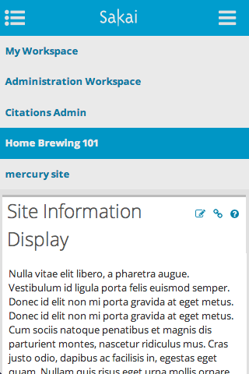

Slide 13
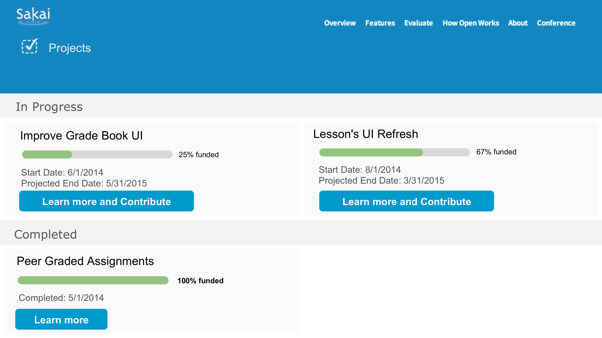
Sakai 11 – User Centered

Slide 14
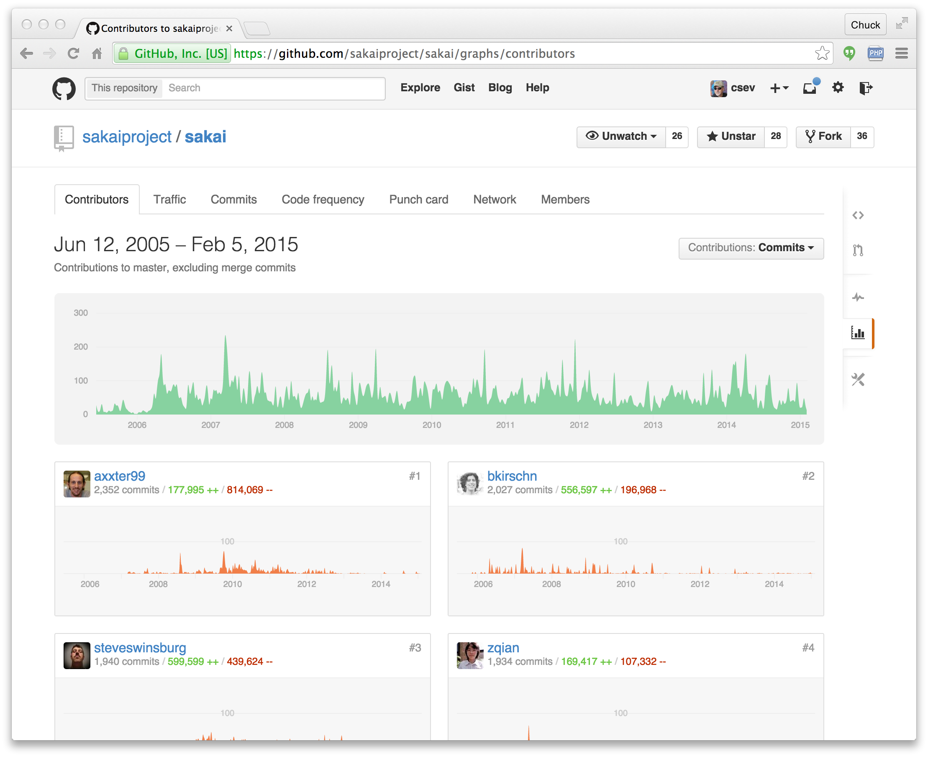
Moved to GitHub

Slide 15
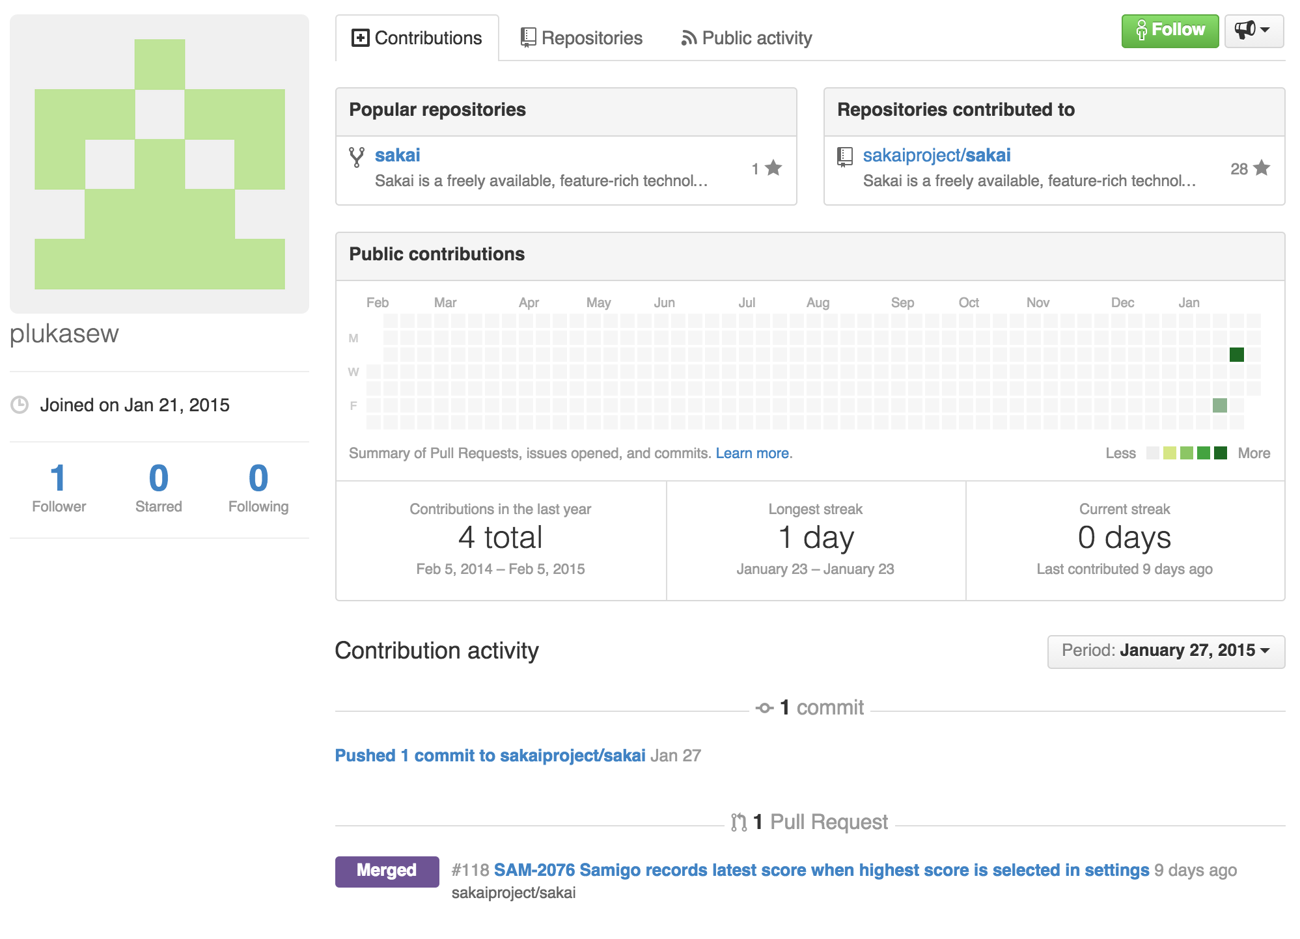

Slide 16
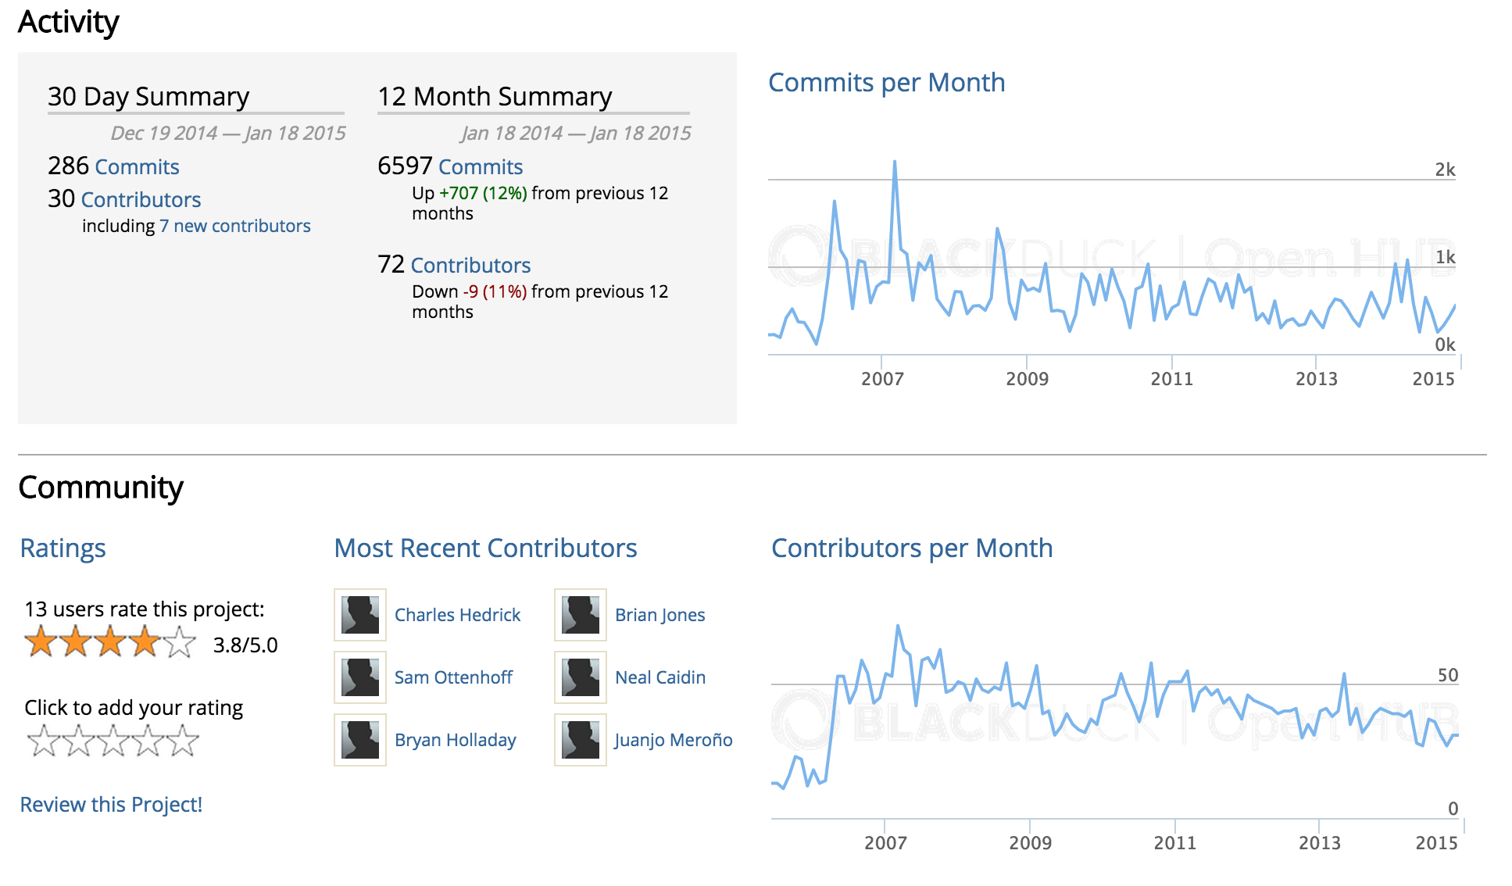

Slide 17
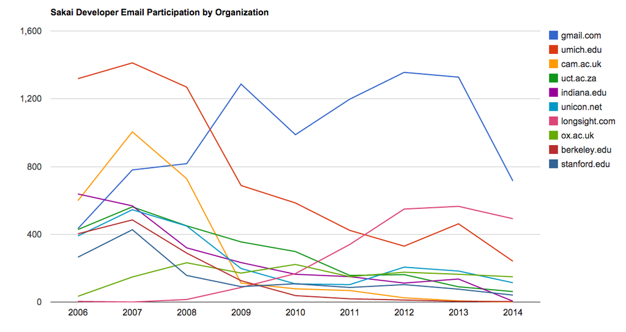

Slide 18
Leadership Emeritus
Berkeley 2010 (*)
Cambridge 2011
Indiana 2013
Stanford 2014 ??
Michigan 2015 ??
I expect some will re-engage as an open source LTI Tool ecosystem emerges
* Last year of major contributions

Slide 19
Leadership
Rutgers
Oxford
Cape Town
Longsight
Notre Dame
Duke
Marist
...

Slide 20
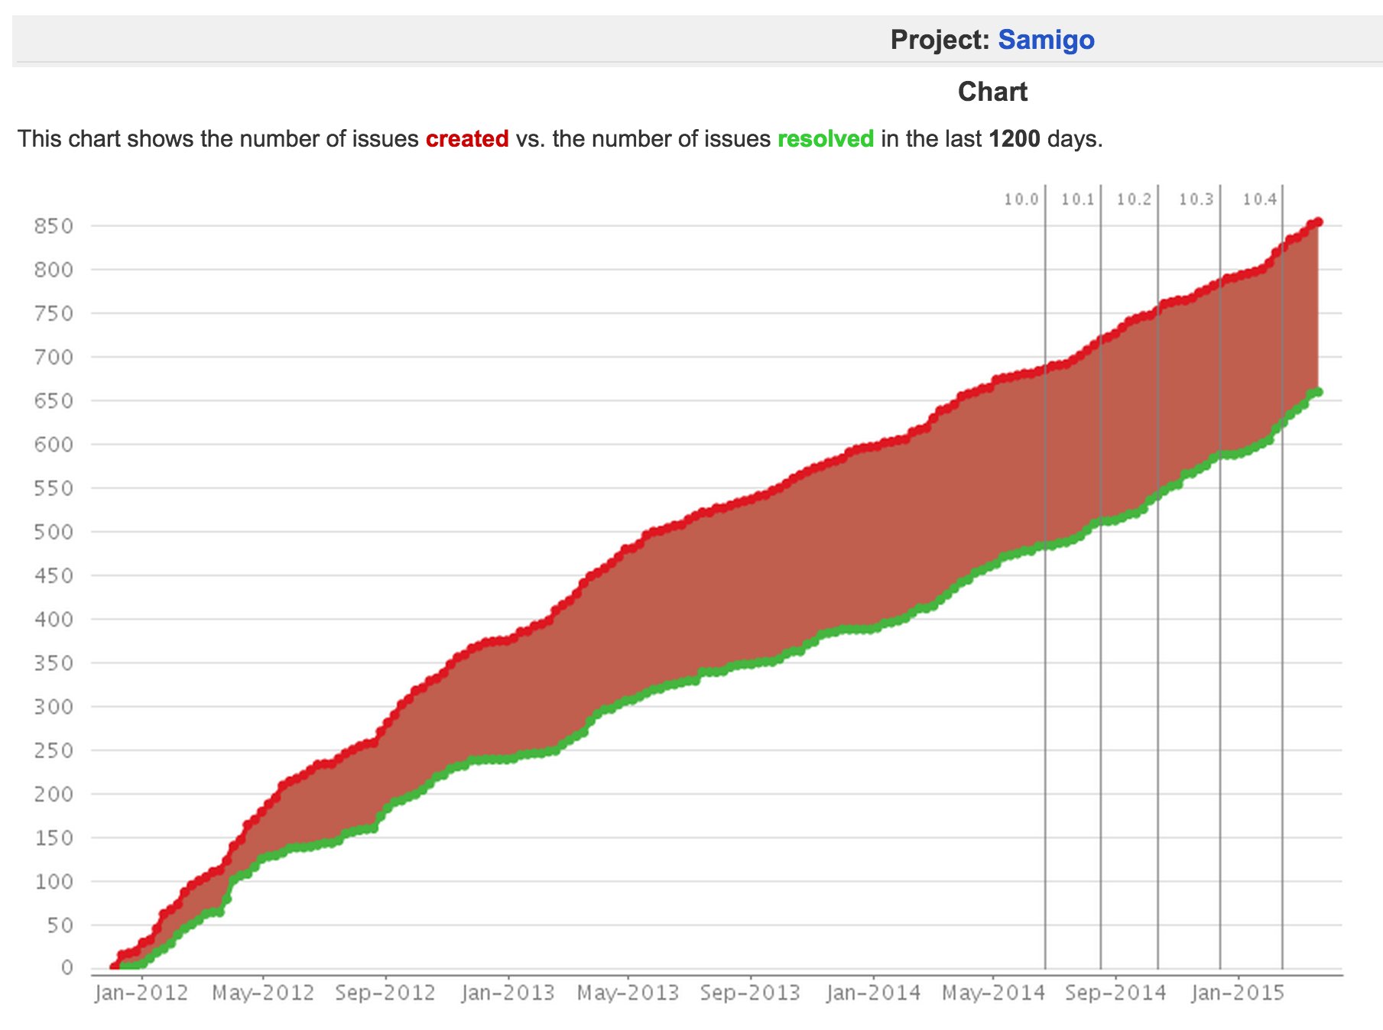


Transitions

Slide 21
Sakai 12 – Dream Big?
12?
11
2.9
10
2.6
2.7
2.8
2.5
2.0
There has never been a better time to dream big in Sakai.
1.0
1.5

Slide 22
An Open Ecosystem
New Standards
IMS LTI 2.0, IMS LTI Services, Content Item, Content Repository, IMS Caliper, IMS CASA
Apereo Open Analytics Initiative
Tsugi Tool Building Environment
LTI Starter Kit (Java)
Karuta Portfolio Project
...
www.apereo.org

